Slide 1
Amazon Machine Learning Using Baseball Statistics
Adam Scerra

Slide 2
Why I chose this project
Large data set
Data set ranges over the past 144 years
I wanted to find a trend that would show and predict how the amount of stolen bases in a season has changed over time.

Slide 3
What the project does
My project examines the stolen bases per player from the year 1871 and compares it with stolen bases per player from the year 2015
By looking at these two data sets we can see how the amount of stolen bases per player has changed over time

Slide 4
Tools that I used
I used Amazon Web Services (AWS) to load and analyze my data
I used Amazon Machine Learning
Then created Amazon Machine Learning Datasource
Then used Machine Learning Model Performance to view my model

Slide 5
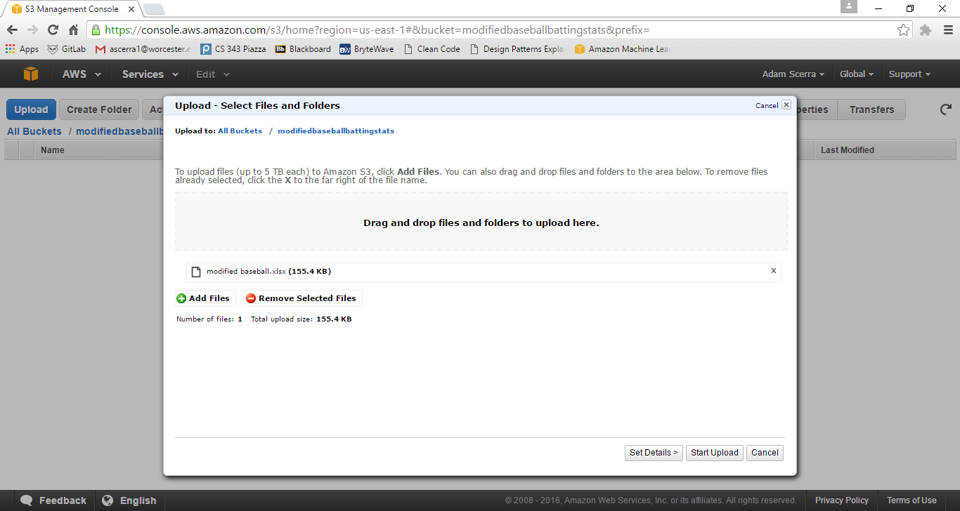
I uploaded the data into (S3) as a file named modifiedbaseball

Slide 6
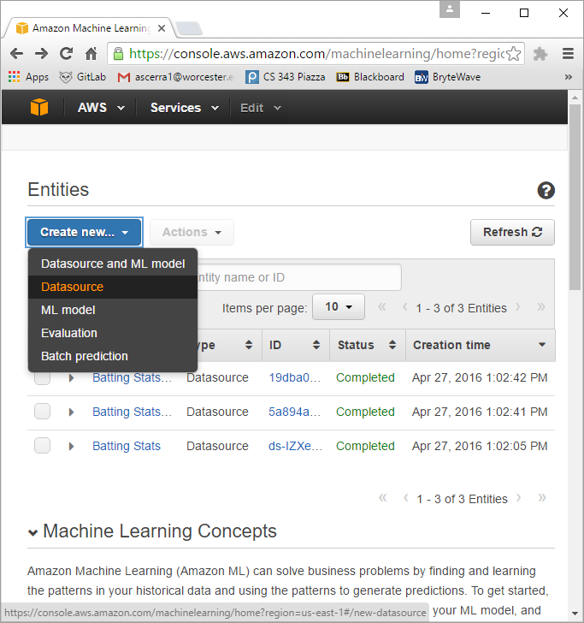
Then created Amazon Machine Learning Datasource

Slide 7
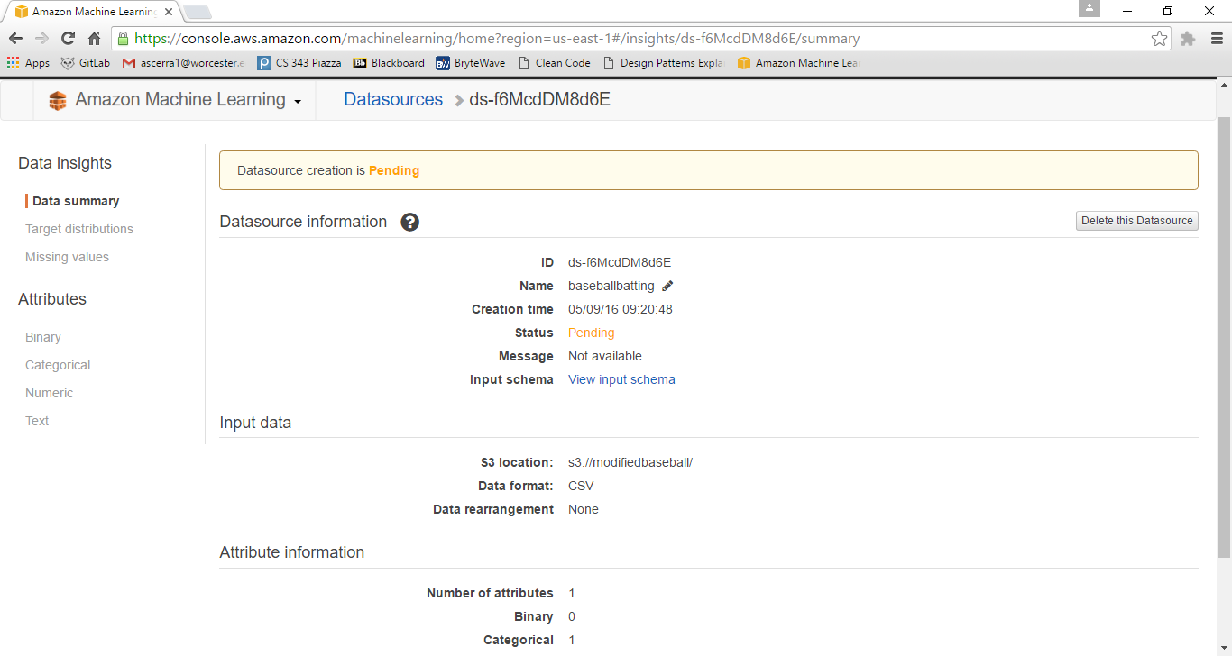
I needed to upload the S3 File I had created then the Datasource was ready to be created.

Slide 8
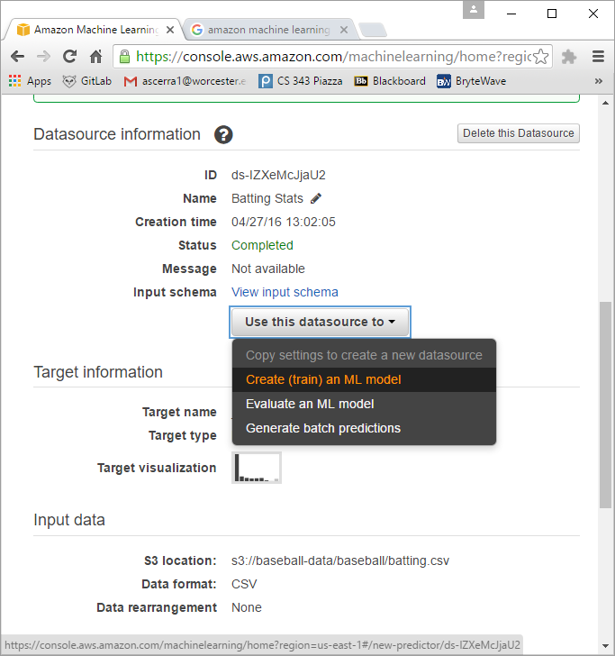
Once it had completed I used the Datasource to create a ML Model which would compare and analyze the Datasource

Slide 9
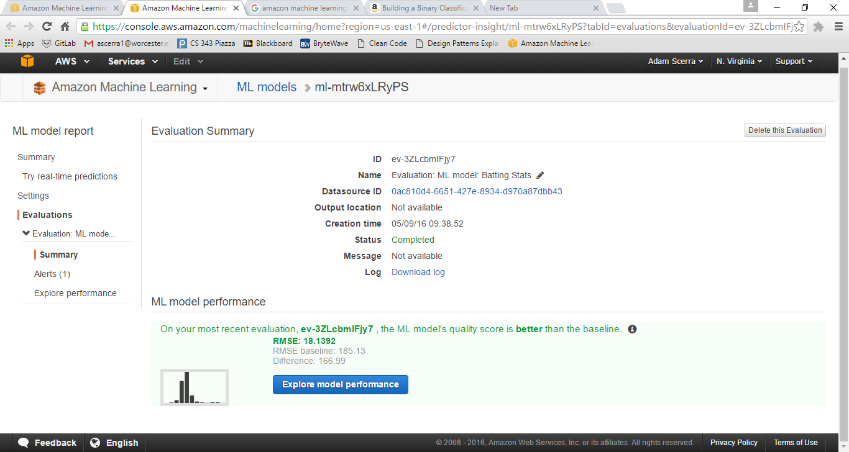
With my model built, I could evaluate and explore the model performance

Slide 10
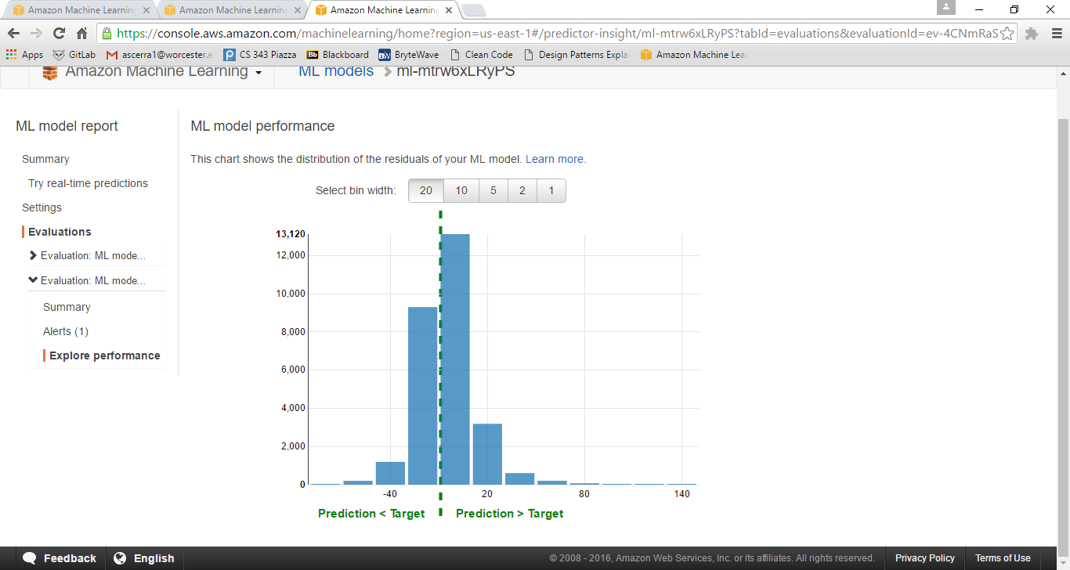
This histogram tells us that my model has a tendency to over predict the amount of stolen bases per player. And that 0-20 is the most likely outcome

Slide 11
Results of my model
Variable 9 is Stolen Bases
There was a differential of 6.5 more stolen bases per player in 2015 then in 1871

Slide 12
What I had to learn
I had to learn how to properly set the Schema for a data set
I had to learn how to properly read the histogram
Also I learned that some outliers should be removed to make my model more accurate

Slide 13
Analysis of a dataset
How the data was selected
- I selected the data by searching for the most in depth data set I could find
- The data came from https://kaggle.com/seanlahman/baseball

Slide 14
Pre-processing of data, and cleaning
I had to take only two years and compare them since the data set was large enough just by doing that
Also I had to delete some outliers to make the model more accurate
Some players had zero stats for the whole season so I removed them

Slide 15
Example of Data Set
Player Name
Year Played
Stolen Bases
victosh01 | 2015 | 1 | BOS | AL | 33 | 94 | 10 | 23
victosh01 | 2015 | 2 | LAA | AL | 38 | 84 | 9 | 18
villaca01 | 2015 | 1 | SLN | NL | 35 | 8 | 0 | 0
villajo01 | 2015 | 1 | HOU | AL | 53 | 116 | 18 | 33
villape01 | 2015 | 1 | CIN | NL | 29 | 6 | 0 | 1
vinceni01 | 2015 | 1 | SDN | NL | 26 | 0 | 0 | 0

Slide 16
Results/Recap
The results that I came up with is that there was an average differentiation of 6.5 more stolen bases per player in the year 2015 then the year 1871.

